Slide 1
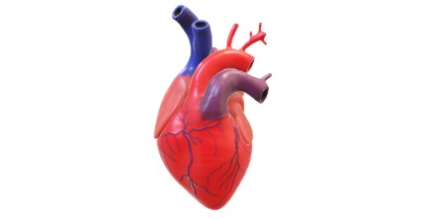
Group 3 Presentation
Presentation by group 3
Group Name:
Myroslav Protsiv
Caleb Allen
Ling B
Belay Hagos

Slide 2

Introductions
This project is focused on the healthcare industry for identifying heart disease.
Our team emphasizes achieving a model performance with a recall value exceeding 75%. Because, high recall is of utmost importance in a medical context, where missing a patient with potential heart disease could have serious consequences.
Our group team is focused on the following classification model technique’s.
K-Nearest Neighbors (KNN)
Support Vector Machine (SVM)
Random Forest
Decision tree
Logistic Regression
Neural Network
We will recommend the best performance of the model for identifying the heart diseases.

Slide 3
Purpose:
Develop a model to predict the likelihood of patients developing chronic heart disease and accurately identify individuals with heart disease.
Assessing whether the model can enhance early prediction capabilities may enable timely intervention and effective management of heart disease.
Uncover patterns, distributions, and relationships within the data
Evaluate the high recall of the True positive case

Slide 4
Data Preprocessing
We use the csv file and read using spark and converted into pandas' data frame.
We separate our categorical and numerical feature.
We checked the dataset data types and convert as necessary.
The categorical feature was encoded using get dummies().
The dataset also check for outliers and how the data is distributed.
The datasets are also split in to”x” and “y” features and target arrays to make it ready for modeling.

Slide 5
Standard Scaling and Transformation
The data is also split into train and test dataset
The “x” feature is standardize using standard scaler.
The “x” and “y” trained feature are fitted
The “x” train and “x” test are transformed

Slide 6
Modeling techniques
K-Nearest Neighbors (KNN)
Support Vector Machine (SVM)
Random Forest
Decision tree
Logistic Regression
Neural Network
The model has been defined.
A grid search with cross-validation has been conducted.
The best parameter and score have been printed.
Additionally, the classification report has been printed for assessment.
We checked for over fitting

Slide 7
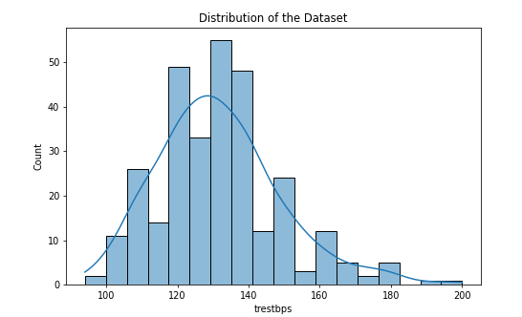
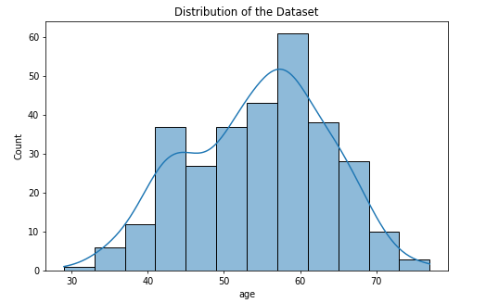
Data Visualization Distribution of the dataset
We plot the chart to show the distribution of the dataset on numerical feature.
Here is sample of our chart

Slide 8
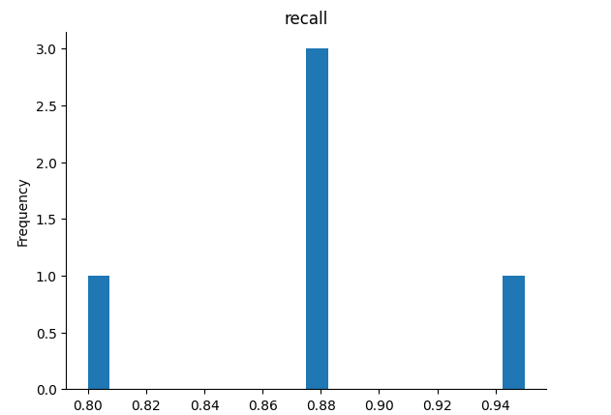
Support Vector Machine (SVM) Recall value.
Shows recall value of 95%

Slide 9
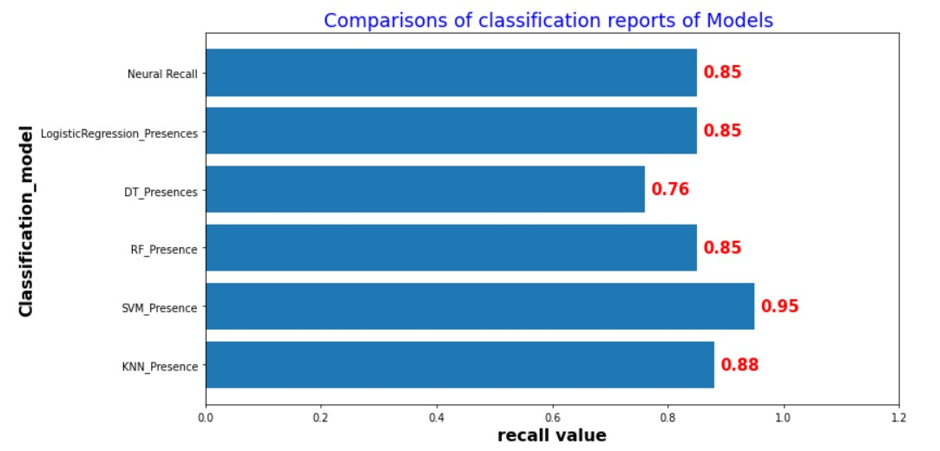
Comparisons of the classification model. Data visualization
Out of the 6 modeling techniques the vector support machine did well on identifying of the heart disease.
Recall value of 95%

Slide 10
Conclusion
Based on the results on recall value, our team recommend using the support vector machine to help identify any presence of heart disease. The SVM identified the most heart disease. With recall value of 95%. This will help control the consequences of having heart disease and will help early intervention for treatment.

